Slide 1
OGC API Hackathon 2019
London, United Kingdom
20 June 2019

Slide 2
Welcome Note
Geovation Hub and Ordnance Survey staff

Slide 3
OGC staff on hand
Scott Simmons
Denise McKenzie
Gobe Hobona

Slide 4
Why OGC APIs?
OGC web service standards should be more flexible with respect to current and emerging IT trends
OGC standards should be far more easy to use by developers
OGC has long provided guidance to make standards more modular
OGC Web Services (OWS) Common was an attempt to retroactively build a common core for W*S standards… now we have a chance to do this proactively!

Slide 5
OGC Board of Directors guidance – why Hackathons are working
Get to 90% of a standard really fast…
Then take time to finish the last 10%
Make the 90% product available to stakeholders and implementers to test
Develop a repository of example implementations
Be more public for the 90%
Control the 10% in the OGC process to ensure the final product is truly an “international consensus standard”

Slide 6
Old news
Used since 2012 in GeoPackage
Mostly used to manage text for OGC
New news
More repos are public
Let the users contribute
Relax the rules during compilation
Now in use
Document from the developer’s perspective
Used in OGC API efforts
Retrofit of older standards by numerous parties

Slide 7
OGC API family of standards
Modernization of web service standards (W*S) started with Web Feature Service v. 3
Additional standards in the hackathon investigating the same pattern:
Processing
Map Tiles
Coverages
Standards will be named “OGC API - [resource]”
OGC API - Features, OGC API - Processes, etc.
Establishing a common core
OGC API - Common
Old W*S standards don’t go away, but will have less focus for future revision

Slide 8
This is not completely new…
CTO discussions with OpenAPI Initiative (2016)
CTO Open APIs White Paper [16-019r4]
OAB discussions on OpenAPI (2017)
Call-out to members experimenting with OpenAPI (2017)
See earlier example from UKHO
OGC staff OpenAPI definitions for WMTS (2017)
Spatial Data on the Web Working Group (2017)
Best Practices document detailing more “webby” web services use cases and requirements
OGC WFS3 Hackathon (2018)
Testbed 14 – NextGen Thread (2018)
Two Engineering Reports [18-045] and [18-021]
MetOcean Hackathon for WCS (2018)

Slide 9
Goal and Objectives

Slide 10

Goal & Objectives
Goal
To advance the development of OGC API specifications
Objectives
Develop, deploy and test services/clients that support OGC APIs
Suggest improvements for a common core
Define rules/guidance that can be documented
Validate work that has been completed to date
Contribute to the GitHub repos

Slide 11
Can we converge on a common core?
All OGC Web API efforts are equal stakeholders
Some borrowing or convergence is already happening
Hack away and find those “building blocks” that are universal to all candidate standards
Improve guidance on use of Web APIs

Slide 12
Expected output from participants
Running services/clients
Suggestions for a common core
Rules/guidance that can be documented
Validation of work completed to date
Contribute to the GitHub repo

Slide 13
Agenda

Slide 14
Day 1 – Thursday 20 June 2019
09:00hrs - Welcome note (Geovation Hub Staff)
09:15hrs - Goals and objectives (OGC DKM & SWG Chairs)
09:30hrs - Introduction to the Draft Specifications (Common, Features, Map Tiles, Processes, Coverages)
11:00hrs – Split into teams by specification
11:10hrs – Team-based work starts [define the problem/scope]
12:30hrs - Lunch
13:30hrs - Resume [come up with multiple options]
17:00hrs - Early Dinner
18:00hrs - Resume [select the preferred option]
20:00hrs - Back-briefs from each team
21:00hrs - Adjourn

Slide 15
Day 2 – Friday 21 June 2019
08:00hrs - Goals and objectives (OGC DKM & SWG Chairs)
08:30hrs - Resume team-based work [implement the preferred option]
12:00hrs - Third back-briefs from each team [ "alignment report" to brief on any deviation from Core as provided at start]
12:30hrs - Working Lunch [complete implementation of the preferred option]
13:30hrs – Joint work on Common or Resume team-based work [implement the preferred option]
14:30hrs – Show & Tell (Demonstration of clients accessing services)
15:30hrs - Final back-briefs
16:30hrs - Closing note (OGC COO)
17:00hrs - Close

Slide 16
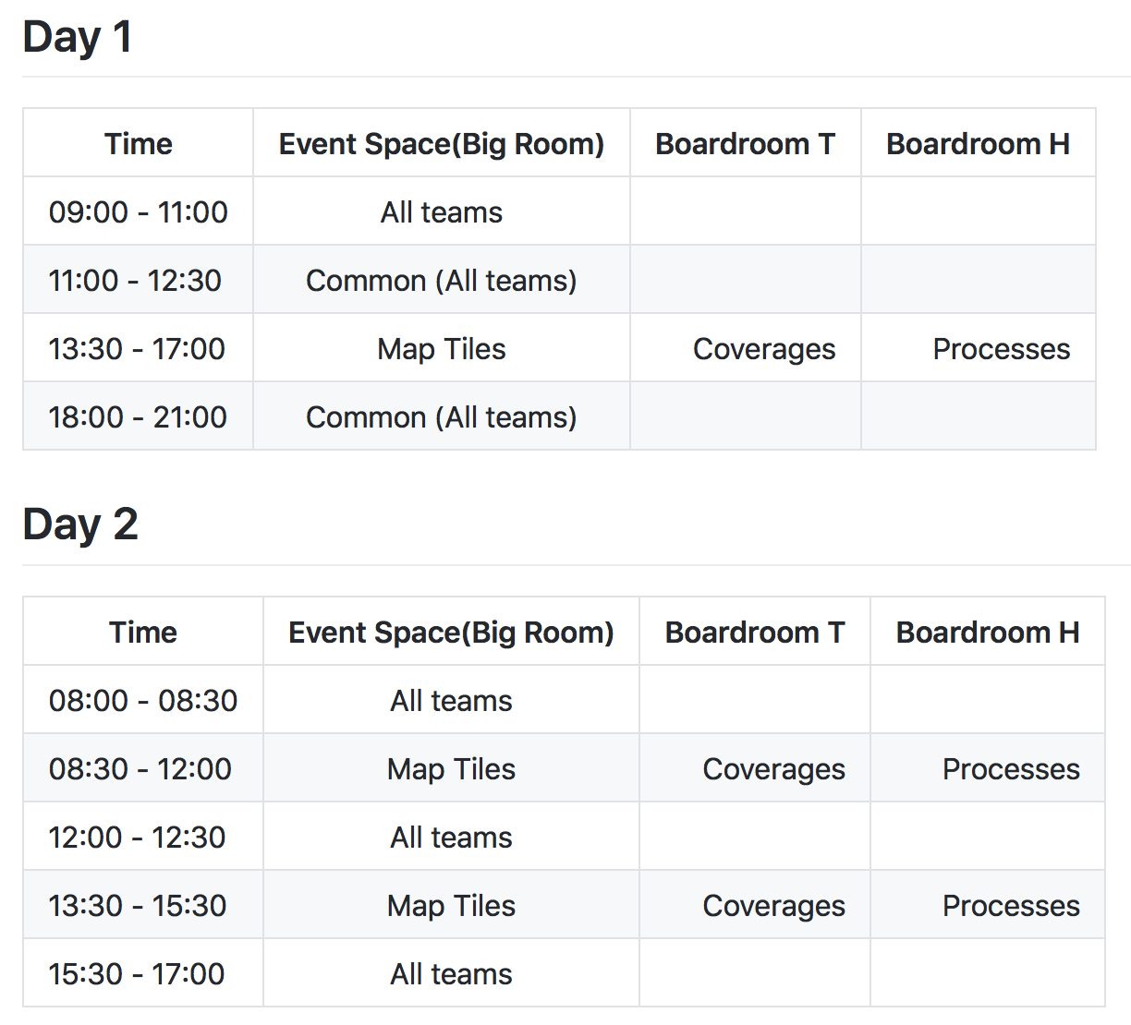
Room Allocation

